Slide 1

CSE326 PROJECT
TOPIC:- RESTAURANT
NAME | REGD.NO. | CLASS ROLL.NO
Somasekhar Ravada | 12219881 | 66
JRSS Deepak | 12219731 | 37
SECTION :- KOC26
SUBMITTED TO :- ADHIRAJ SIR

Slide 2
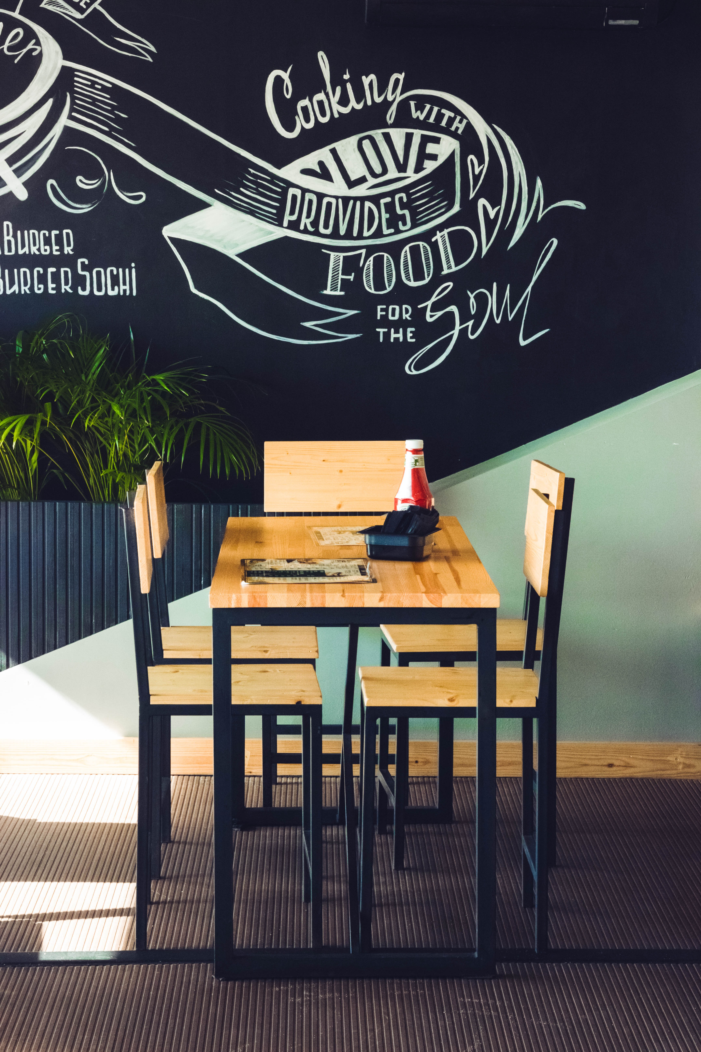
INTRODUCTION
The Restaurant website Lets you build a Brand
It let people find you online.
People look online for contact details such as
Phone number , address ,and opening times. A
Restaurant website allows you to control the
Image of your restaurant , and gives customers
To book online or easily find your address, which
Can be the deciding factor of whether a customer choose to dine at your restaurant.

Slide 3
THE LIST OF VARIOUS HTML TAGS USED IN THE WEBSITE :
<div> Creating Containers</div>
<h1> Heading Tag </h1>
<section> Creating various sections </section>
<p> Paragraph Tag </p>
<a>Anchor Tag </a>
<img> Image Tag </img>
<li> To create lists </li>
<input> Tags for taking input from the user </input>
MAJOR TAGS USED :
<main>
<head>
<link>
<body>

Slide 4
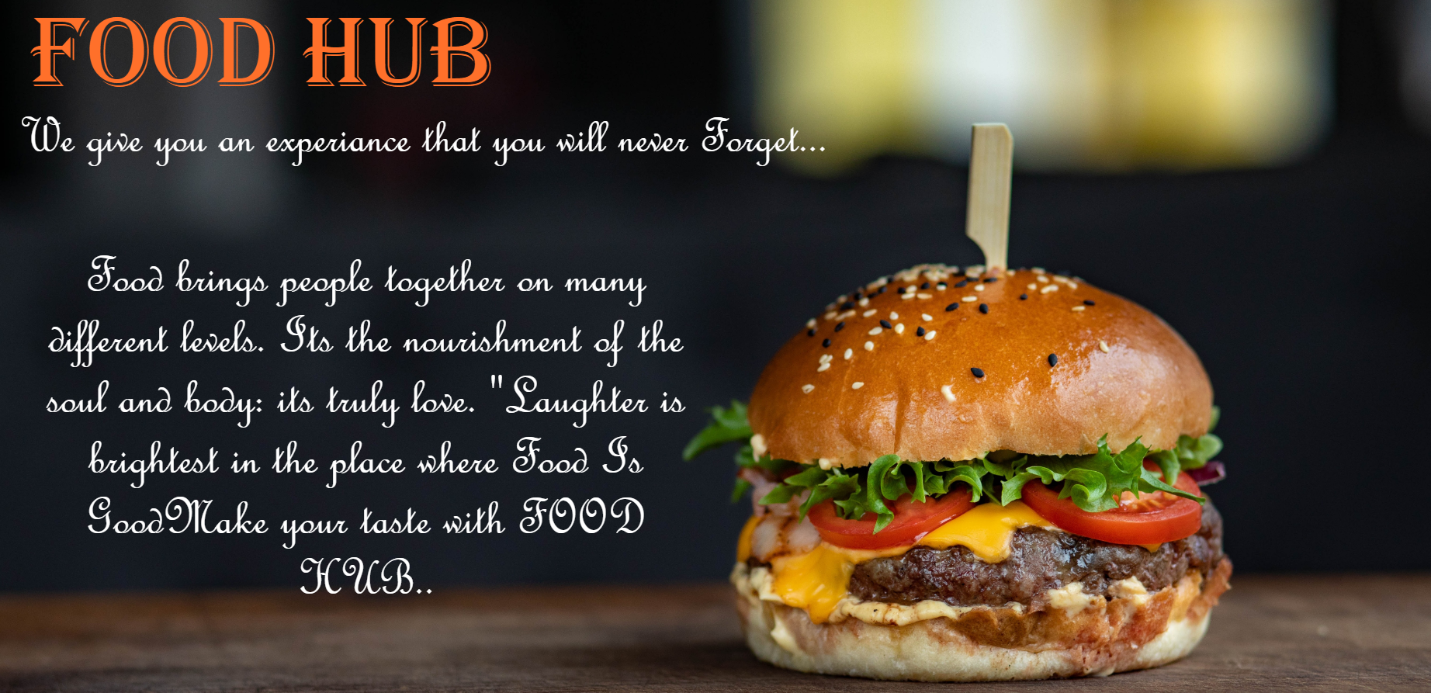
THE HOME PAGE
Helps to create First impression om our customers to attract them . As the Description says , how the food is prepared in our Restaurant in Good Quality..

Slide 5
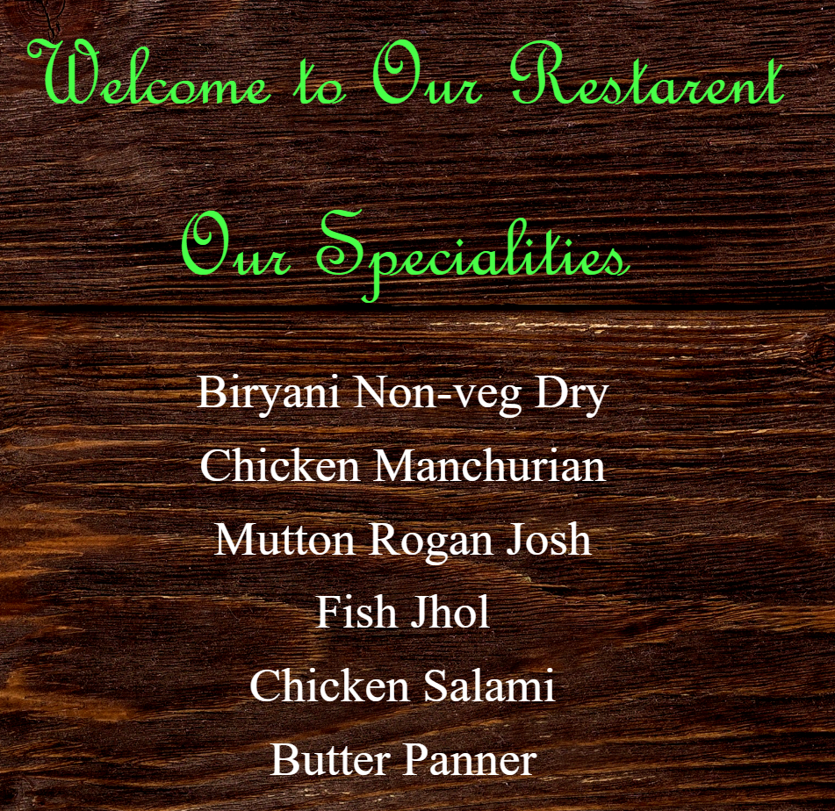
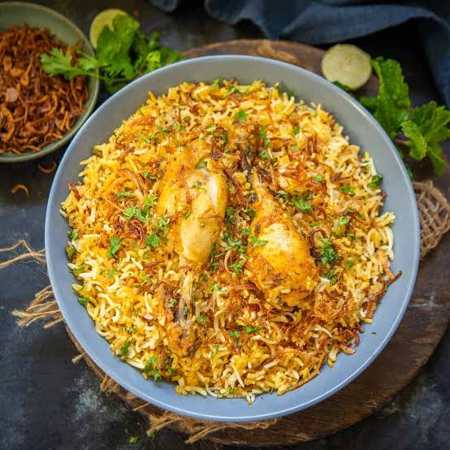
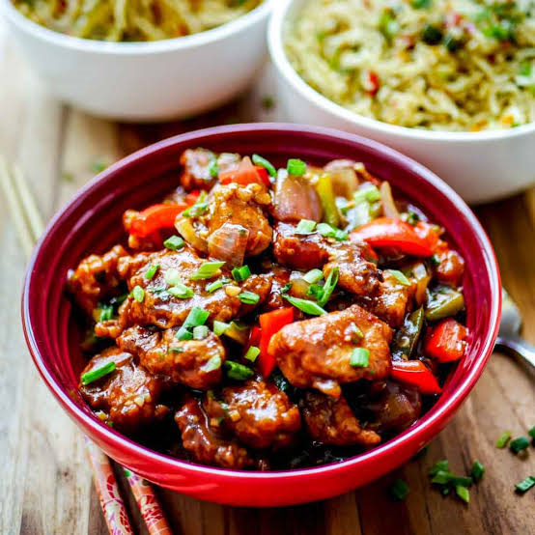
OUR SPECIALS
Showing all special items of our Restaurant that are very popular in all times. Where people can make their choice
relevant food.

Slide 6
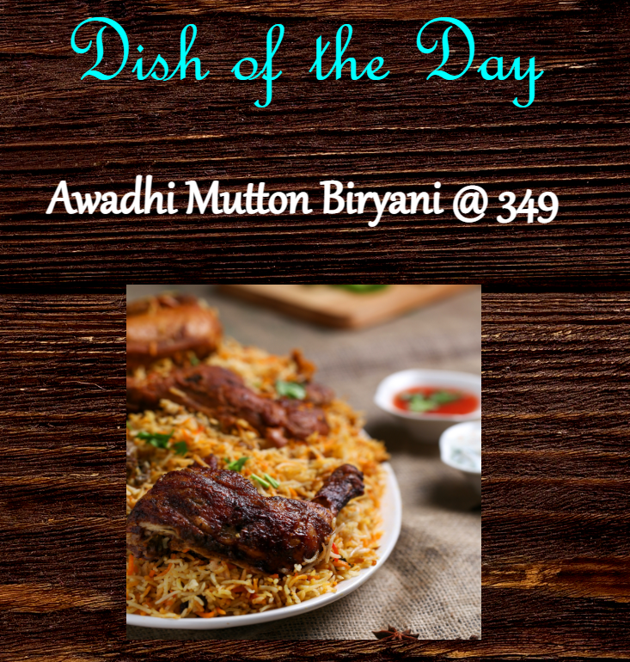
DISH OF THE DAY
Every customer Love to have some Surprise. So we have planned to make a Special Recipe every day and make customer Happy.

Slide 7
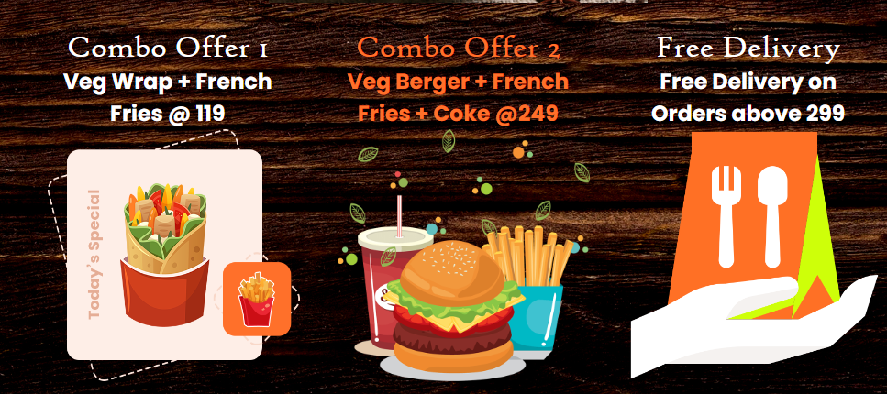
COMBO OFFERs
AS we all LOVE to these kind of FOOD (Burger, pizza, Wrap, French Fries etc.) So also providing the various kind of FOOD which customer can enjoy even more while eating.

Slide 8
THANK YOU

